Slide 1

AI Sentiment Analysis on Hacker News
Tracking public sentiment and topics on AI/LLMs

Slide 2

Project Overview
Build an automated system to track AI/LLM discussions on Hacker News
Analyse sentiment and key discussion aspects (ethics, jobs, tools, etc.)
Visualize trends over time using Power BI

Slide 3

Phase 1 – Data Collection
Retrieving AI and LLM Discussions from Hacker News
Use Hacker News API Endpoints
Filter stories by AI keywords: AI, GPT, Claude, Anthropic, LLM
Collect: title, URL, timestamp, score, author, comments
Recursively fetch nested comments
Store in JSON/DB via n8n automation

Slide 4
Phase 2: Data Pre-processing
Clean and prepare text for sentiment analysis
Remove HTML, code, emojis, special characters
Normalize text (lowercase, punctuation cleanup)
Tag metadata: model names, keywords, aspects
Tools:
n8n Function node (basic cleaning)
Python (Pandas + regex) for advanced processing

Slide 5
Phase 3: Sentiment & Aspect Analysis
Classify sentiment and detect discussion aspects
Approaches:
LLM-based: GPT-4, Claude, local LLaMA → JSON output
Example: { sentiment: "positive", aspects: ["speed", "accuracy"] }
Classical NLP: VADER, TextBlob, BERT, spaCy
Combine keyword/aspect extraction (LDA/topic modeling)
Manual annotation for test set
Run through n8n for automated scoring

Slide 6

Phase 4: Data Storage & Transformation
Prepare processed data for visualization
Store in PostgreSQL or Google Sheets
ETL (n8n or Python) aggregates:
Avg. sentiment per model
Sentiment trends over time
Frequency of topics/aspects

Slide 7
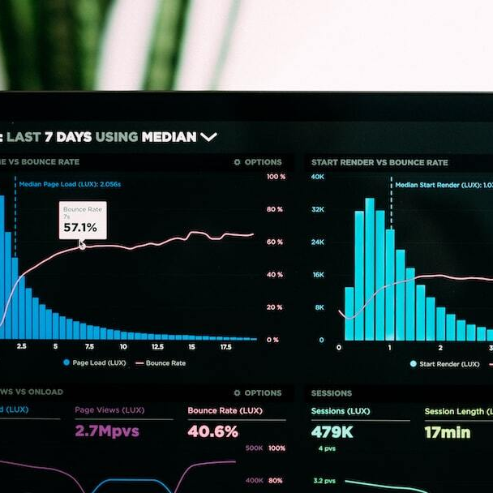
Phase 5: Visualization Dashboard
Present insights through Power BI
Connect Power BI to DB or CSV output
Key visuals:
  Sentiment over time
  Top topics/aspects
  Positive/negative ratio by model
  Aspects breakdown with clickable comments
Alternative: Streamlit or Grafana

Slide 8
Phase 6: Automation & Maintenance
Keep the entire pipeline live and updated
Daily n8n workflow schedule
Automatic fetching → Analysis → DB append
Power BI auto-refresh via API
Optional: Alerts for sentiment spikes

Slide 9

Q&A / Discussion

